Slide 1
Module3_Part2 Textbook : Operating Systems Concepts by Silberschatz
Operating SYSTEMS

Slide 2
Process synchronisation
when several processes access and manipulate the same data concurrently and the
outcome of the execution depends on the particular order in which the access
takes place, is called a race condition.
To avoid race condition, processes are to be synchronized in some way.
To do process synchronization, we should first to know what a critical section is.

Slide 3
Critical section
Consider a system consisting of n processes {Po, P1 , ... , Pn _ I}.
Each process has a segment of code, called a critical section in which the process may
be changing common variables, updating a table, writing a file, and so on.(shared)
Part of the program where the shared memory is accessed is called critical section or
critical region of that process
when one process is executing in its critical section, no other process is to be allowed to
execute in its critical section. That is, no two processes are executing in their critical
sections at the same time. If so we can avoid race conditions.

Slide 4
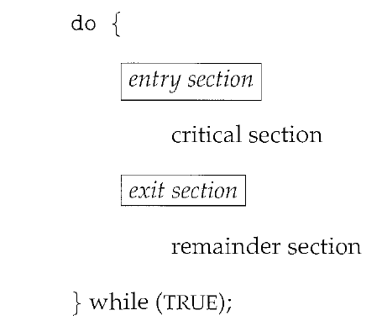
Critical section
The critical-section problem is to design a protocol that the processes can use to cooperate.
Each process must request permission to enter its critical section. The section of code
implementing this request is the entry section. The critical section may be followed by an
exit section. The remaining code is the remainder section.
The general structure of a typical process Pi is shown in

Slide 5
Critical section
A solution to the critical-section problem must satisfy the following three requirements:
1. Mutual exclusion. If process Pi is executing in its critical section, then no
other processes can be executing in their critical sections.
2. Progress. If no process is executing in its critical section
some processes wish to enter their critical sections,
then only those processes that are not executing in their remainder sections can participate in deciding which will enter its critical section next,
this selection cannot be postponed indefinitely.
3. Bounded waiting. There exists a bound, or limit, on the number of times
that other processes are allowed to enter their critical sections, after a
process has made a request to enter its critical section and before that
request is granted.

Slide 6
Peterson’s solution
One of the process synchronization mechanism
Peterson's solution is a classic software-based solution to the critical-section problem
it provides a good algorithmic description of solving the critical-section problem
Peterson's solution is restricted to two processes that alternate execution between their
critical sections and remainder sections.
The processes are numbered Po and P1.

Slide 7
Peterson’s solution
The two processes share two variables:
int turn;
boolean flag[2]
The variable turn indicates whose turn it is to enter the critical section
The flag array is used to indicate if a process is ready to enter the critical section.
flag[i] = true implies that process P_{i} is ready!

Slide 8
Algorithm for Process P_{i}
while (true){
flag[i] = true;
turn = j;
while (flag[j] && turn = = j)
;
/* critical section */
flag[i] = false;
/* remainder section */
}

Slide 9
Structure for p0 structure for p1
Initially flag[0] and flag[1] assigns false
while (true){
flag[0] = true;
turn = 1;
while (flag[1] && turn = = 1)
;
/* critical section */
flag[0] = false;
/* remainder section */
}
while (true){
flag[1] = true;
turn = 0;
while (flag[0] && turn = = 0)
;
/* critical section */
flag[1] = false;
/* remainder section */
}

Slide 10
Peterson’s solution
A solution to the critical-section problem must satisfy the following three requirements:
1. Mutual exclusion.
2. Progress.
3.Bounded waiting.

Slide 11
Structure for p0 structure for p1
while (true){
flag[0] = true;
turn = 1;
while (flag[1] && turn = = 1)
;
/* critical section */
flag[0] = false;
/* remainder section */
}
while (true){
flag[1] = true;
turn = 0;
while (flag[0] && turn = = 0)
;
/* critical section */
flag[1] = false;
/* remainder section */
}
P0 and p1 willing
P1 in CS and p0 wants to enter
P0 in CS and p1 wants to enter
P0 wants to enter and P1 has no interest

Slide 12
Structure for p0 structure for p1
while (true){
flag[0] = true;
turn = 1;
while (flag[1] && turn = = 1)
;
/* critical section */
flag[0] = false;
/* remainder section */
}
while (true){
flag[1] = true;
turn = 0;
while (flag[0] && turn = = 0)
;
/* critical section */
flag[1] = false;
/* remainder section */
}
P0 wants to enter and P1 has no interest
If p0 wants to enter ,it is possible, we can say there is progress

Slide 13
Structure for p0 structure for p1
while (true){
flag[0] = true;
turn = 1;
while (flag[1] && turn = = 1)
;
/* critical section */
flag[0] = false;
/* remainder section */
}
while (true){
flag[1] = true;
turn = 0;
while (flag[0] && turn = = 0)
;
/* critical section */
flag[1] = false;
/* remainder section */
}
In Peterson algorithm a process will never wait longer than one turn for entrance to the critical section

